Slide 1
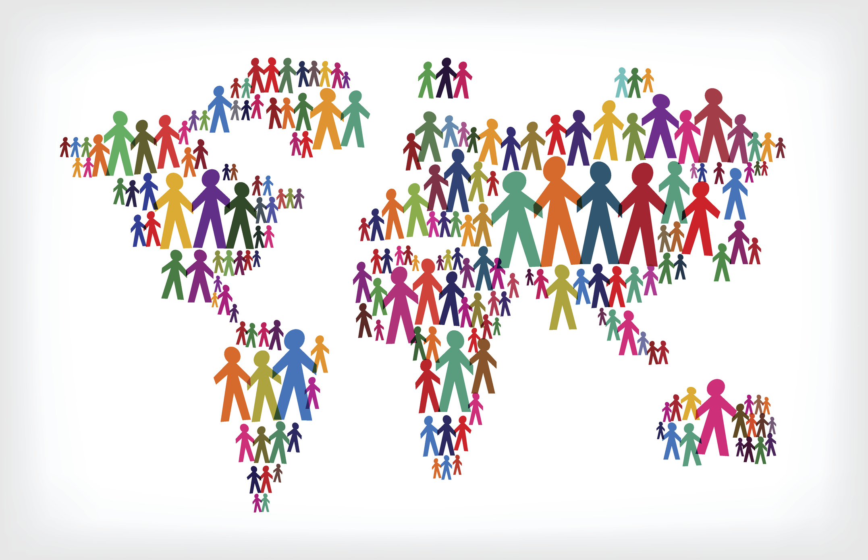

Blank slide
Data Analysis of the World Happiness Report
CSC 302–Winter II AODC Final Presentation Group 5 Alizia Hamilton Olen Justice Judy Wallace
Notes:
This is group 5 – Alizia, Olen and Judy. For our final report we decided to further explore the world happiness report from our midterm.

Slide 2

What Makes People Happy?
Does social support increase happiness?
How does people’s generosity affect their happiness?
What effect does corruption have on happiness?
Notes:
What makes people happy? The UN conducts an annual survey of people around the world asking questions related to six factors. These factors are used to calculate a happiness score rating with the highest being 10.

Slide 3
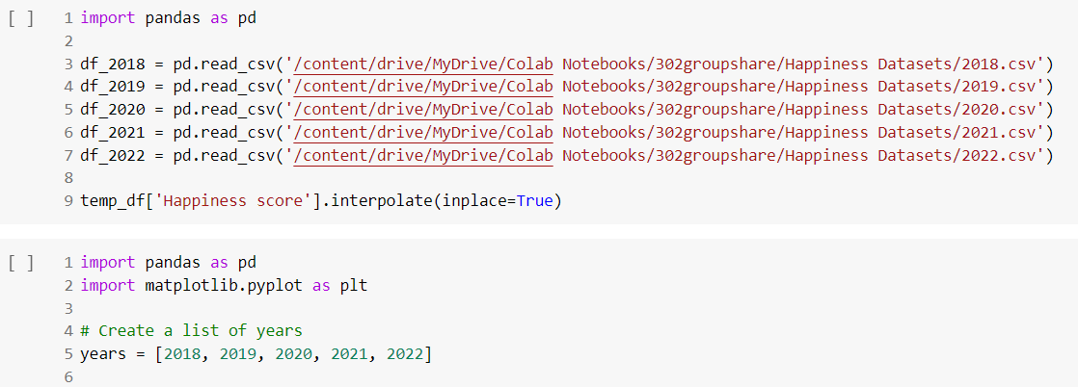
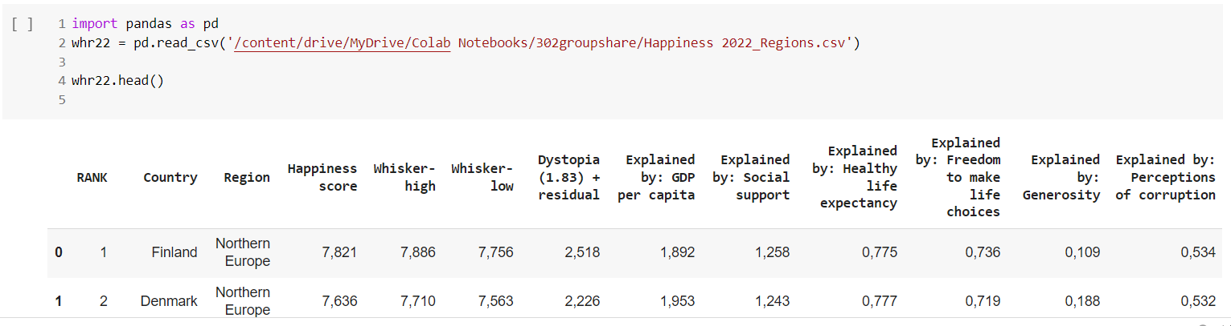
About the Data
Collected from World Happiness Reports 2018-2022.
Happiness based on ratings of GDP per Capita, Health and life expectancy, Social Support, Generosity, Freedom to make life decisions and perception of corruption.
Notes:
We used data from the UN’s World Happiness report years 2018-2022. Our visuals were created in several different tools including python colab, R Studio and Tableau.

Slide 4
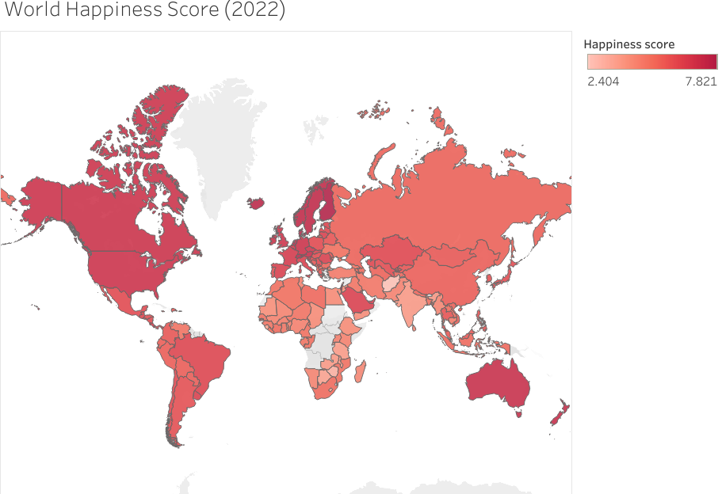
2022 World Happiness Scores
Happiness was ranked on a scale of 0 to 10.
Finland and Demark have been ranked as #1 and #2 happiest countries since 2019
The United States is currently ranked as the #15 happiest country.
Notes:
Happiness around the world on a 1-10 scale. Happier countries in the darker red.

Slide 5
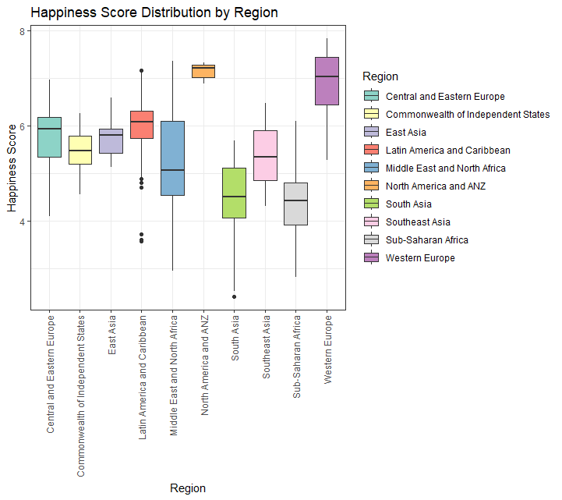
Happiness Score Distribution By Region
The happiness scores in the Middle Eastern and North African, South Asian, and Western European regions exhibit a wide range of variability among their respective countries.
On the other hand, the North America and ANZ region shows lower variability in happiness scores

Slide 6
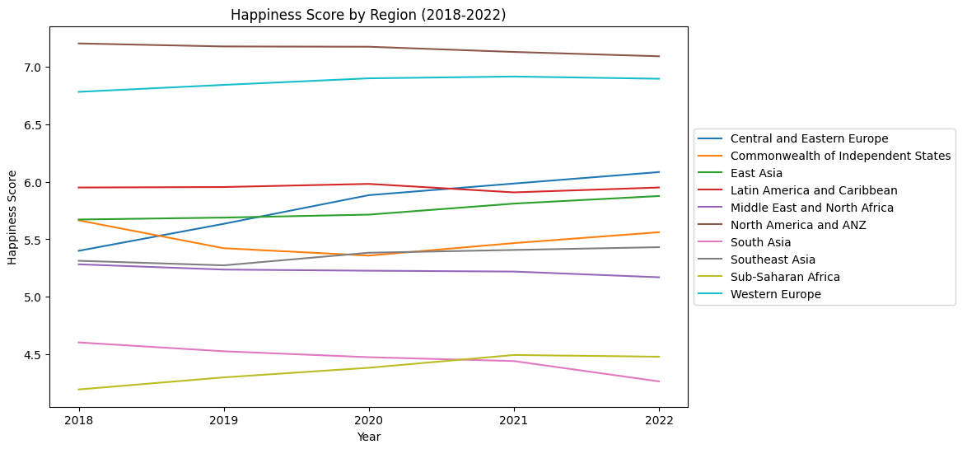
Blank slide
Happiness Data (2018-22)
The overall happiness score has been increasing for most regions from 2018 to 2022, indicating a general improvement in the well-being of people around the world.
The regions with the highest happiness scores consistently across the five years are North America, Australia and New Zealand, and Western Europe.
The regions with the lowest happiness scores are consistently Sub-Saharan Africa and South Asia.
There is some variation in the happiness scores for different regions over time. For example, Latin America and the Caribbean experienced a dip in happiness scores in 2020, which could be due to the COVID-19 pandemic and economic and social disruptions.

Slide 7
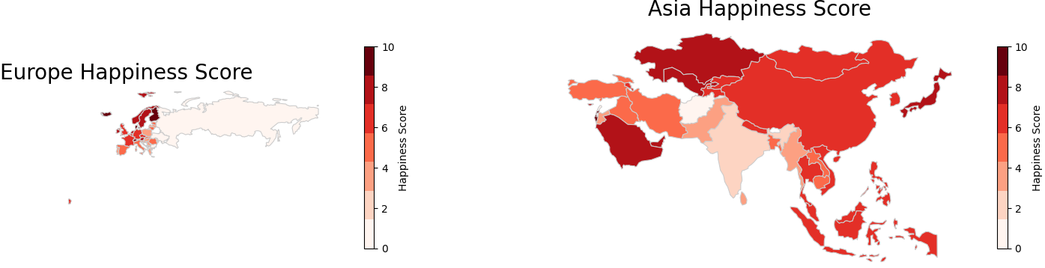
2022 Happiness Region Comparison
This map comparison shows us the difference in happiness scores between countries in Europe and Asia. We see that the happiness scores of European countries tend to be higher than those of Asian countries. We can also see that the distribution of happiness scores in Europe is more uniform, with most countries having a score above 5, whereas in Asia the distribution is more varied, with some countries having very high scores and others having very low scores. This could be because of cultural, social, and economic factors that contribute to differences in happiness between these two regions.

Slide 8
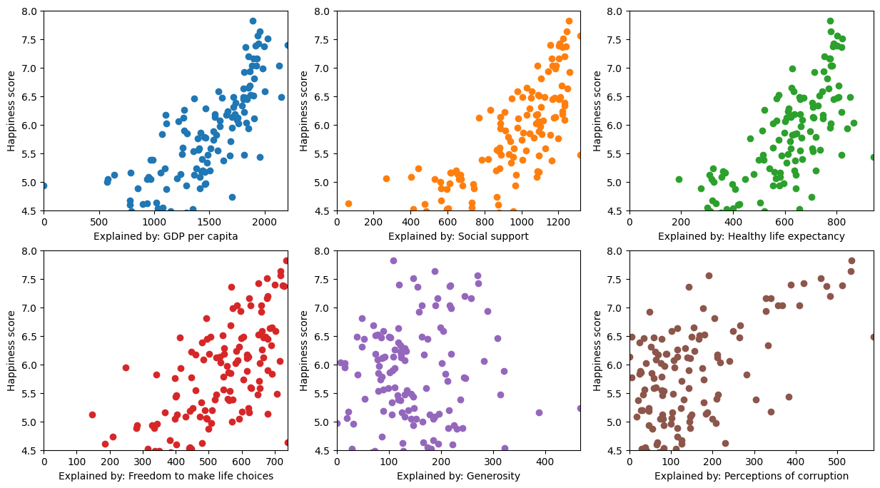
Blank slide
The Factors Surveyed to Score Happiness
Notes:
From the scatterplots shown here, we can see that there is a general positive correlation between each factor and the happiness score. However, the strength of the correlation varies across the factors.
In the midterm we focused on the factors of GDP, Personal Freedom and Life Expectancy which had the strongest correlation. In the following slides we focus on the other factors that contribute to happiness – Social Support, Perception of Corruption and Generosity.

Slide 9
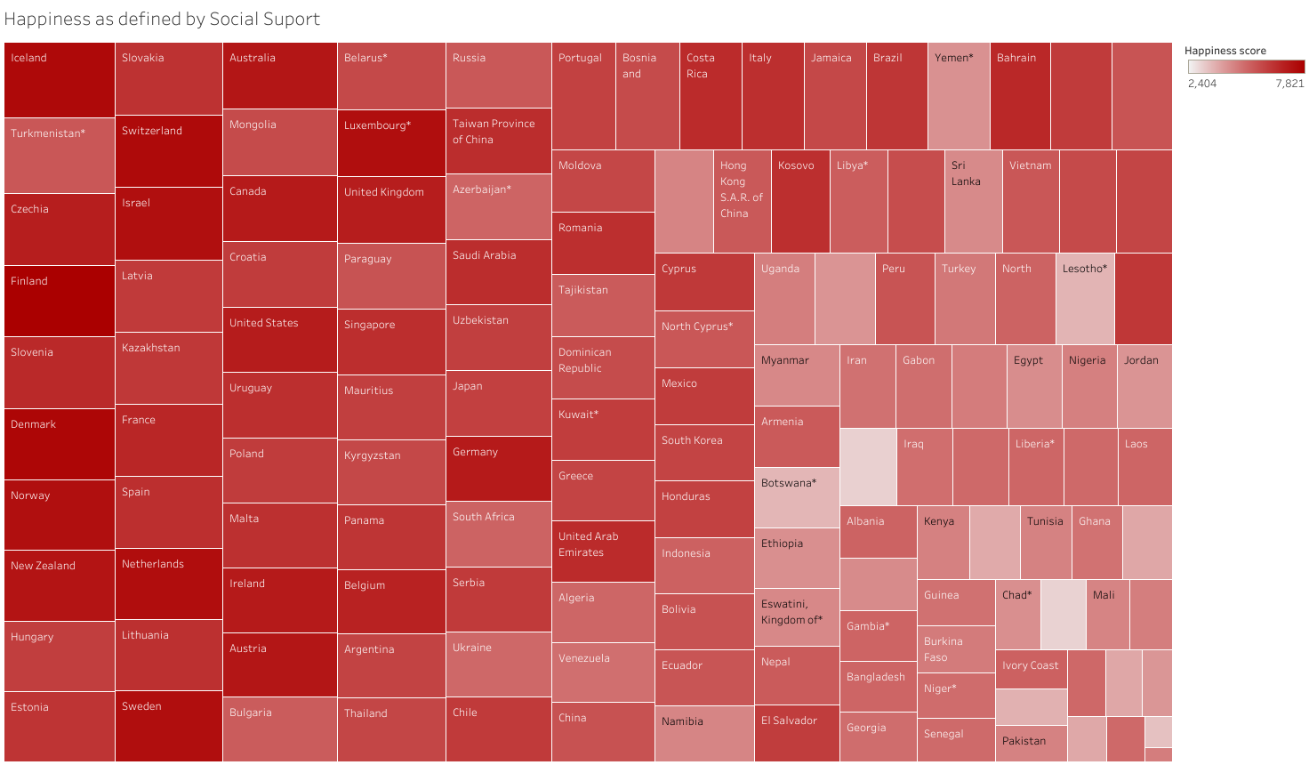
Blank slide
Happiness as defined by Social Support all Countries
Social support in this study is defined as having a close friend or relative you can count on when in need.
The answers were taken as a binary yes or no.
The chart seems to indicate countries with citizens that have more social support tend to be happier.
Notes:
Hi this is Judy. After reviewing the factors of GDP, Freedom to make life choices and life expectancy in our midterm presentation this presentation focuses on the other 3 factors. Here you see box chart covering all the countries surveyed, the darker red color indicates a higher happiness rating and the box size indicates amount of social support, the larger the box the more the support.

Slide 10
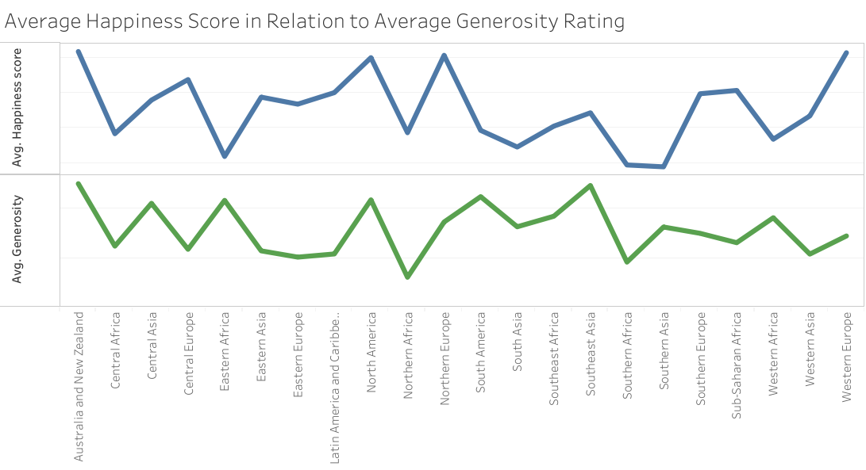
Blank slide
Happiness as Defined by Generosity by Region
Notes:
Generosity is another factor used to determine happiness. This chart shows in some regions there seem to be a correlation between generosity and happiness – but not all. This is especially visible for the outlier on the chart - Eastern Africa, which has a higher generosity paired with lower happiness. Other factors could be in play that affect generosity-but not happiness such as a participating in a religion that asks for followers to tithe or to donate a percentage of income.

Slide 11
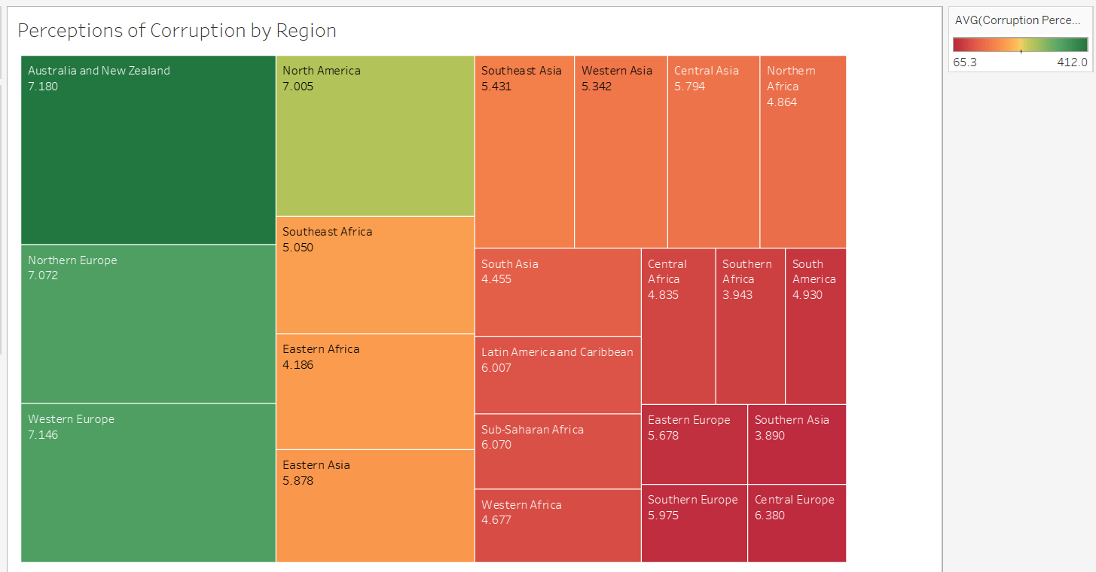
Blank slide
Happiness as Defined by Perception of Corruption
Notes:
For the factor pertaining to Corruption, respondents are asked “Is corruption widespread throughout the government and Is corruption widespread within businesses?” In this visual, we see how perception of corruption in a country relates to happiness. Shown here the larger the shape the higher happiness score, the happiness rating is also shown under the region label. The colors show the corruption score, dark red is the most corrupt and dark green the least.

Slide 12
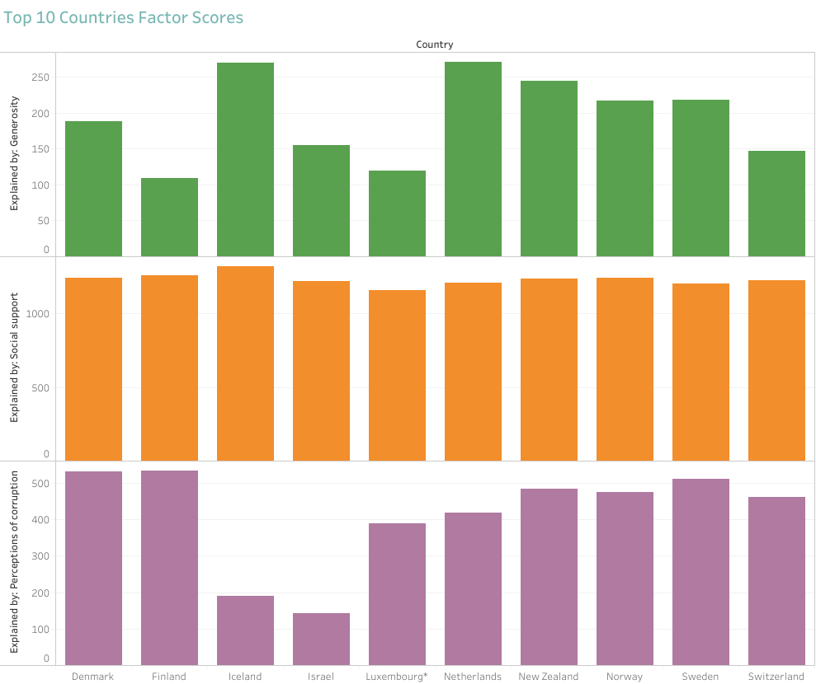
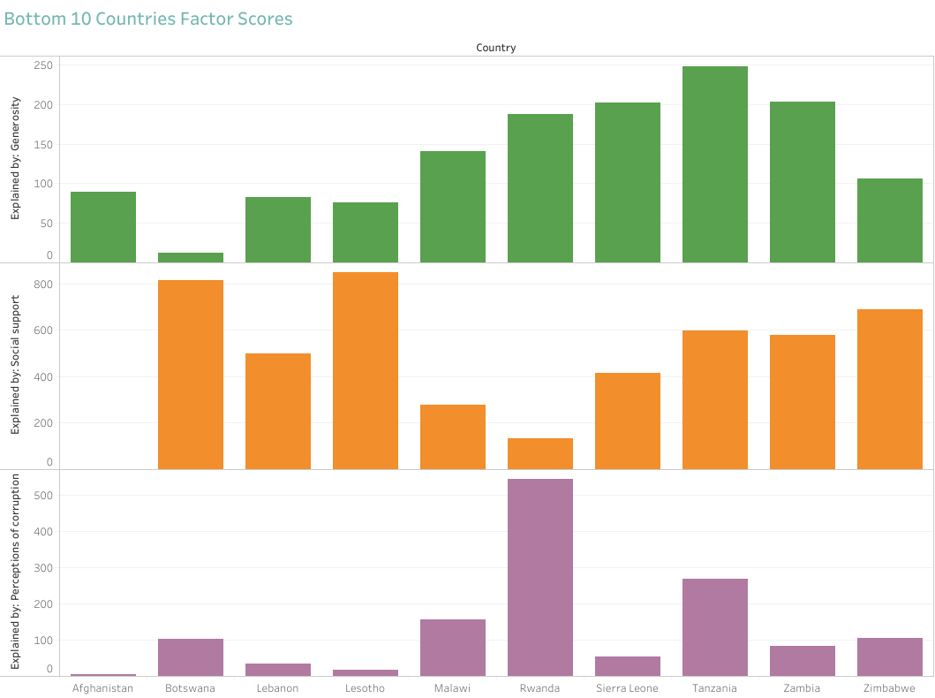
Top 10 and Bottom 10 Factor Comparison
Notes:
By analyzing social support, generosity, and perceptions of corruption in the top 10 and bottom 10 countries for happiness, we can gain insights into the role of these factors in shaping happiness levels and identifying potential areas for improvement in countries with lower happiness scores such as Afghanistan and Botswana.

Slide 13
Blank slide
CONCLUSION
Text text text.
Text text text.
Top 3 Influences on Happiness
Social Support
Perception of Corruption
Generosity

